Slide 1
Feed the Future Zone of Influence Survey
Quality Control and Support
Team Training

Slide 2
Contents
Introduction
Quality control support
Material and human resources support
Moral support
Forms

Slide 3
Contents
Introduction
Quality control support
Material and human resources support
Moral support
Forms

Slide 4
Introduction
Purpose of the survey
Feed the Future is the U.S. Government’s global food security initiative that seeks to:
↓ poverty, hunger, and undernutrition among women and children
↑ resilience, income, women’s empowerment, dietary diversity, and appropriate feeding practices
Zone of Influence (ZOI) Surveys track progress in achieving initiative objectives in ZOI areas where program efforts are concentrated. They are:
Representative cluster sample household surveys
Designed to provide information on Feed the Future indicators with an acceptable level of statistical accuracy

Slide 5
introduction
Roles and responsibilities of the quality control and support (QCS) teams
Are a key quality control mechanism during data collection.
Visit each field team once every week.
Spend 1½–2 days with a field team during each visit.
Must have complete and in-depth knowledge of:
ZOI Survey questionnaire
Interviewer’s Manual, including the anthropometry and the agricultural interviewer manual
Field Supervisor’s Manual
Organization Manual
ZOI Survey ethics and confidentiality protocols

Slide 6
introduction
Roles and responsibilities of the QCS teams (cont.)
Provide an essential range of support to field teams:
Quality control support
Material and human resources support
Moral support
When field teams receive the positive support they need to work effectively and efficiently, team morale and data quality both improve.

Slide 7
Contents
Introduction
Quality control support
Material and human resources support
Moral support

Slide 8
Quality Control Support
QCS team responsibilities
Follow up on automated quality control reports
Observe interviews
Review field supervisor activities
Debrief field team

Slide 9
Quality Control Support
I. Follow up on automated quality control reports
The in-country data manager will provide the QCS team with summary findings after reviewing data collected and submitted by field teams.
The findings will include:
Constructive criticism
Guidance
Positive feedback

Slide 10
Quality Control Support
I. Follow up on automated quality control reports
Ensure that the field supervisor is aware of both positive findings and data quality concerns.
If a concern is identified, ensure that the field supervisor:
Understands the problem
Understands how to best address the problem
Has a plan to improve performance
Follow up to confirm that data quality issues are being adequately addressed.
Ensure that previous data quality problems are not reappearing.

Slide 11
Quality Control Support
I. Follow up on automated quality control reports
Contact the field manager immediately with concerns about any failure to resolve identified data issues.
Document all data quality problems in the Data Quality Control Report Follow-Up form.
(QCS Team Manual Annex A)

Slide 12
Quality Control Support
II. Observe interviews: Field supervisors
During each visit, observe one interview that the field supervisor is observing to ensure that he or she is appropriately observing the interviewer.
Take notes during the interview on the Social Science Interview Observation form.
Observe the field supervisor providing feedback to the interviewer after the interview and provide any additional feedback to the interviewer.
Meet with the field supervisor to provide feedback on his or her performance.
Complete the Feedback on the Field Supervisor Observation form.
(QCS Team Manual Annex B)
(QCS Team Manual Annex C)

Slide 13
Quality Control Support
II. Observe interviews: Interviewers
Observe each interviewer conducting an interview.
Take notes on the Social Science Interview Observation form during the interview. Provide feedback to the interviewer after leaving the household.
Meet with the field supervisor to review observations made during the interviews.
(QCS Team Manual Annex B)

Slide 14
Quality Control Support
II. Observe interviews: What to look and listen for. . .
Selected and recorded correct household.
Entered all household members in roster.
Interviewed all eligible women and children.
Entered interview and module outcome codes correctly.
Followed proper anthropometric procedures.
Asked questions objectively.
Conducted interview professionally.

Slide 15
Quality Control Support
III. Review field supervisor activities
Meet with local authorities.
Compare supervisor’s assignment sheets to interviewer’s assignment sheets.
Review households classified as non-residential, vacant, or demolished.
Review roster spot-checks.
Observe the field supervisor finalizing and transmitting a completed household form.
Observe the field supervisor conducting a daily team meeting.
Document findings.

Slide 16
Quality Control Support
III. Review field supervisor activities
(a) Meet with local authorities
Confirm that the field supervisor met with them before starting interviews in the cluster.
Confirm that the field supervisor answered any questions they had.
Confirm that they have no concerns about the survey.
Thank them for their cooperation and that of their community.

Slide 17
Quality Control Support
III. Review field supervisor activities
(b) Compare supervisor and interviewer assignment sheets
Confirm that assignment of households to interviewers is consistent.
Confirm that status of all interviews is consistent.
Confirm that reassignments of households are documented consistently and completely on:
Supervisor’s assignment sheet
Assignment sheet of the original interviewer A
Assignment sheet of the replacement interviewer A
Confirm that hidden households are handled correctly.

Slide 18
Quality Control Support
III. Review field supervisor activities
(c) Review household classifications
Verify households classified as non-residential, vacant, or demolished on the Supervisor’s Assignment Sheet.
Visit one or two of these locations to confirm that they were coded appropriately.

Slide 19
Quality Control Support
III. Review field supervisor activities
(d) Review roster spot-checks
Confirm that at least one household’s roster was spot-checked for each interviewer in each cluster.
Compare the field supervisor’s roster to the roster data on the interviewer’s tablet to make sure they are consistent.

Slide 20
Quality Control Support
III. Review field supervisor activities
(e) Observe household form finalization and transmission
Observe the field supervisor as he or she:
Finalizes a household form
Archives it on the interviewer’s tablet
Backs it up on the field supervisor’s tablet
Transmits the form to Feed the Future [CONTRACTOR].
If there is no Internet capability in the cluster, you will not be able to observe the transmission.

Slide 21
Quality Control Support
III. Review field supervisor activities
(f) Observe field team meeting
Does the field supervisor:
Solicit examples of successes and challenges?
Comment on interview observations and data quality reviews?
Provide an update on progress?
Encourage questions?
Summarize positive aspects of the field team’s work?
Provide detailed instructions on how to address any performance issues?
Answer questions respectfully and accurately?
Emphasize the importance of any needed changes?
Ensure understanding of procedures that need improvement?
Provide encouragement?

Slide 22
Quality Control Support
III. Review field supervisor activities
(g) Document findings
Document findings on General Field Team QC Report form.
Review the forms with the field supervisor to ensure an understanding of all issues and procedures that require improvement.
Keep the forms and refer to them at the start of the next visit.
Discuss any recurring problems with the field manager.
(QCS Team Manual Annex D)

Slide 23
Quality Control Support
IV. Debrief field team
Debrief the field team at end of the visit.
Use clear, specific, and actionable examples of observed weaknesses and strengths.
Be constructive and provide:
Positive reinforcement for good performance
Useful, practical suggestions or improving performance
Provide ample opportunity for questions.
Ensure that all field team members understand any issues and how to improve their work.

Slide 24
Quality Control Support
IV. Debrief field team
Complete the Team Debriefing Report form.
Keep a copy of the report to review before the next QCS team visit.
Discuss any recurring issues with the field manager to determine an action plan.
(QCS Team Manual Annex E)

Slide 25
Contents
Introduction
Quality control support
Material and human resources support
Moral support
Forms

Slide 26
Material AND Human resources Support
Material support
Coordinate with field supervisors to identify shortages in team supplies.
Acquire and deliver any needed supplies to teams during field team visits.
Use the Field Team Resupply Checklist to document:
All supplies requested
Date the supplies were requested
Date the supplies were delivered
Submit a copy of the checklist to your field manager and keep a copy.
(QCS Team Manual Annex F)

Slide 27
Material AND Human resources Support
Human resources support
Personnel issues may arise during fieldwork, such as a field team member:
Falling ill
Being injured
Requiring dismissal (inability or refusal to comply with fieldwork procedures)
Discuss issues with the field supervisor and determine an action plan.
Document personnel issues in the Provision of Human Resources Support to Field Teams form.
Submit a copy of the form to your field manager and keep a copy.
(QCS Team Manual Annex G)

Slide 28
Contents
Introduction
Quality control support
Material and human resources support
Moral support
Forms

Slide 29
Moral Support
Why is it needed?
Survey fieldwork is physically challenging.
Walk long distances and deal with difficult terrain
May experience vehicle breakdowns, bad weather, illness
Survey fieldwork is emotionally challenging.
Away from families and loved ones
Away from the comforts of home for weeks
Conducting interviews can be stressful.
Boosting morale benefits staff well-being and fieldwork quality.

Slide 30
Moral Support
QCS team responsibilities
Always be supportive—even when addressing problems.
Convey appreciation.
Ensure that team members understand that they are valued and are key to the success and quality of the survey.

Slide 31
Moral Support
Providing moral support
Consider doing the following:
Make a small gesture (e.g., bring cold drinks or snacks to the team).
Make a thoughtful inquiry into team members’ well-being.
Tailor support to each team’s circumstances.
Record moral support that the team needs and the support provided on the General Field Team QC Report during each visit.
(QCS Team Manual Annex D)

Slide 32
Contents
Introduction
Quality control support
Material and human resource support
Moral support
Forms

Slide 33
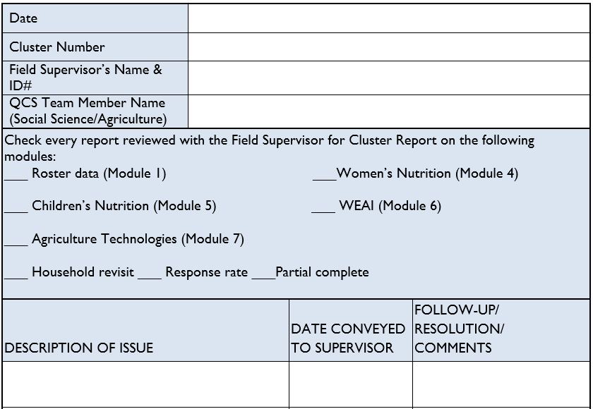
Annex A. Data Quality Control Report Follow-Up

Slide 34
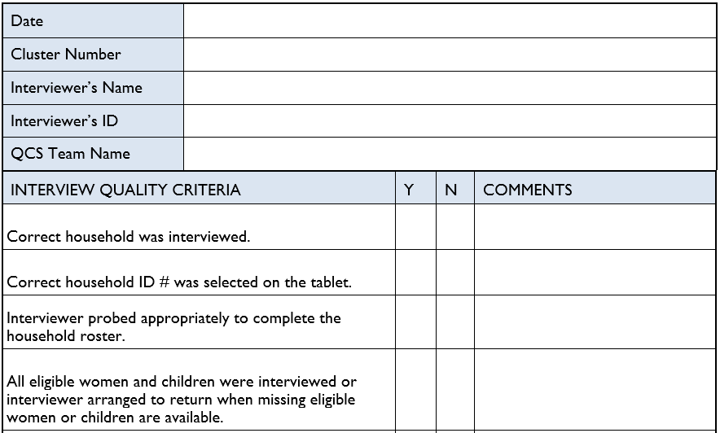
Annex B1. SOCIAL SCIENCE Interview Observation

Slide 35
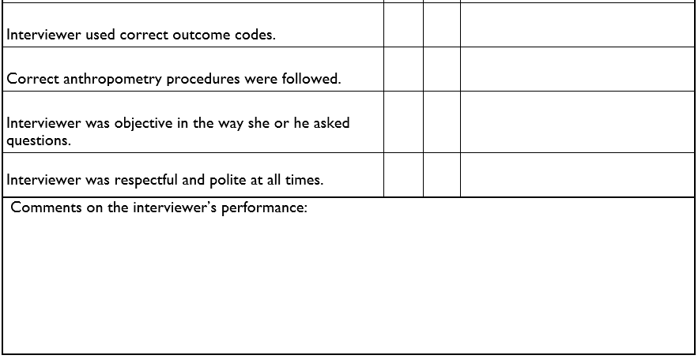
Annex B1. SOCIAL SCIENCE Interview Observation

Slide 36
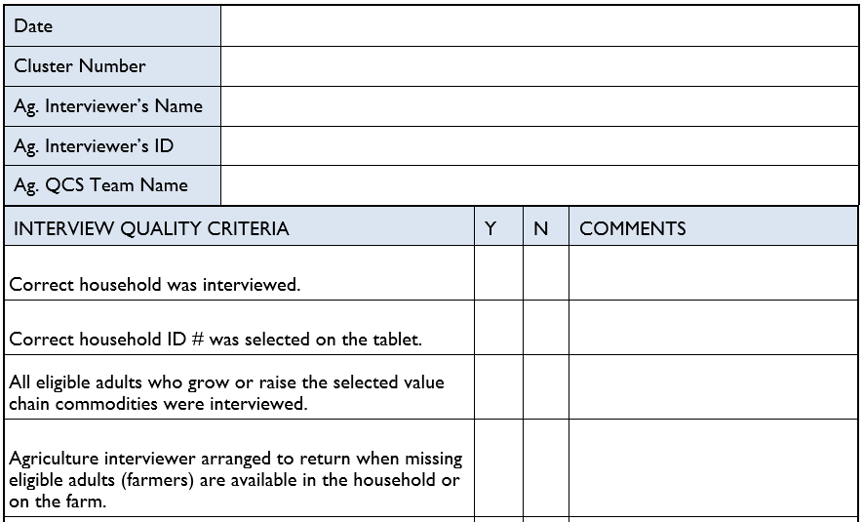
Annex B2. AGRICULTURE Interview Observation

Slide 37
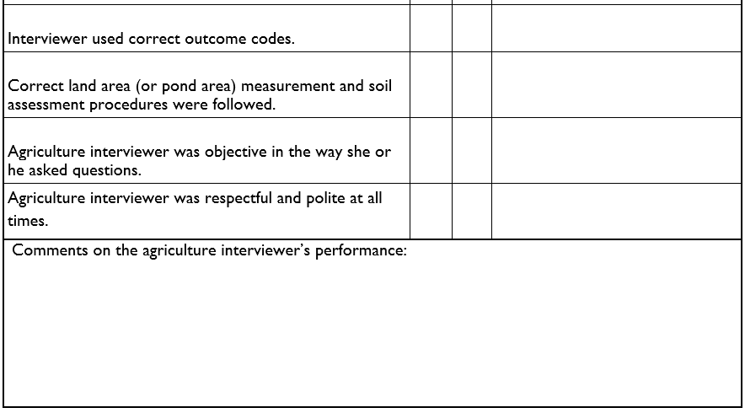
Annex B2. AGRICULTURE Interview Observation

Slide 38
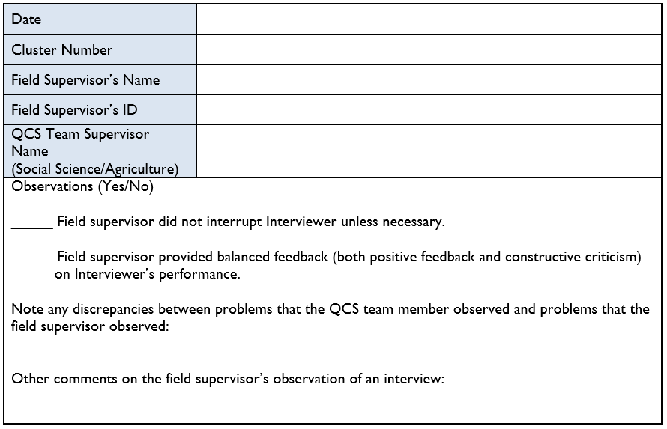
Annex C. Feedback on Field Supervisor Observation of an Interview

Slide 39
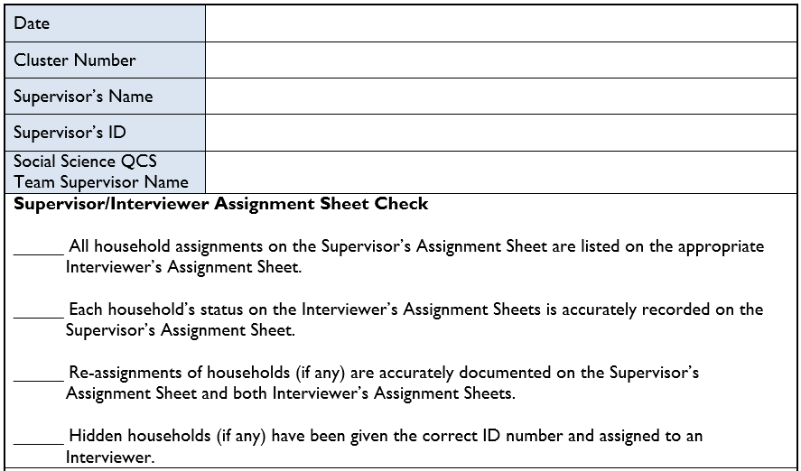
Annex D. General Field Team QC Report

Slide 40
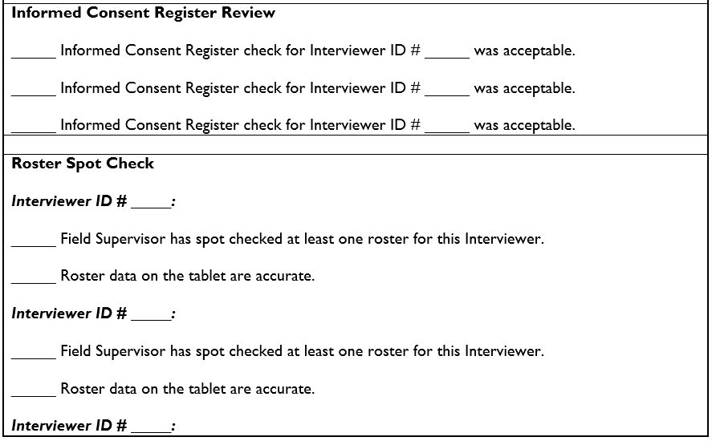
Annex D. General Field Team QC Report

Slide 41
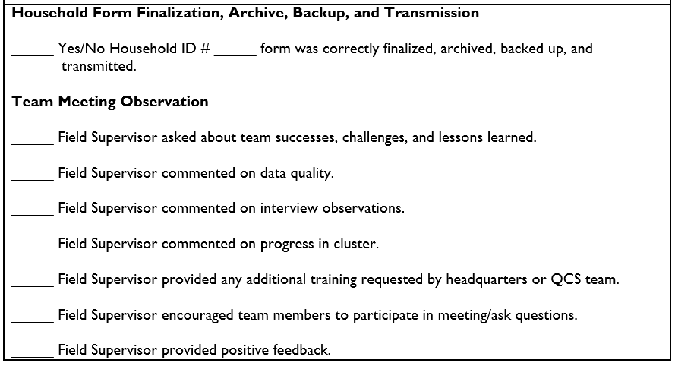
Annex D. General Field Team QC Report

Slide 42
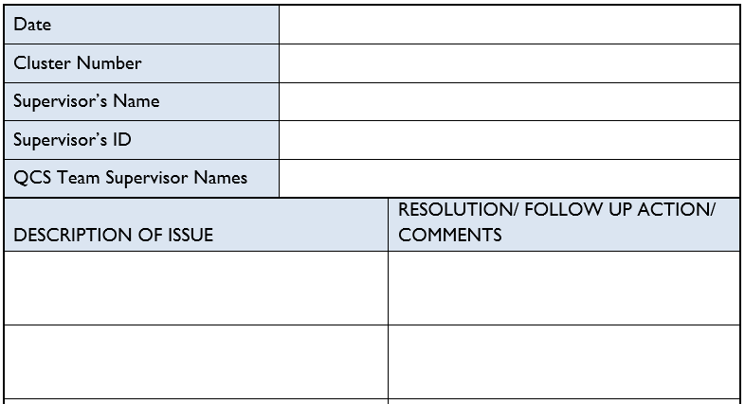
Annex E. Team Debriefing Report

Slide 43
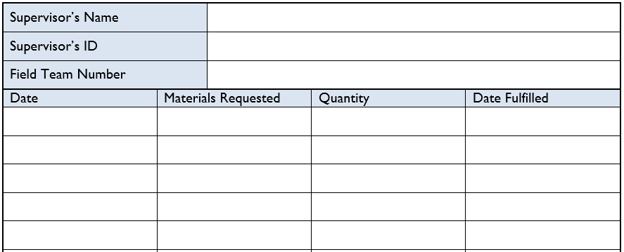
Annex F. Field Team Resupply Checklist

Slide 44
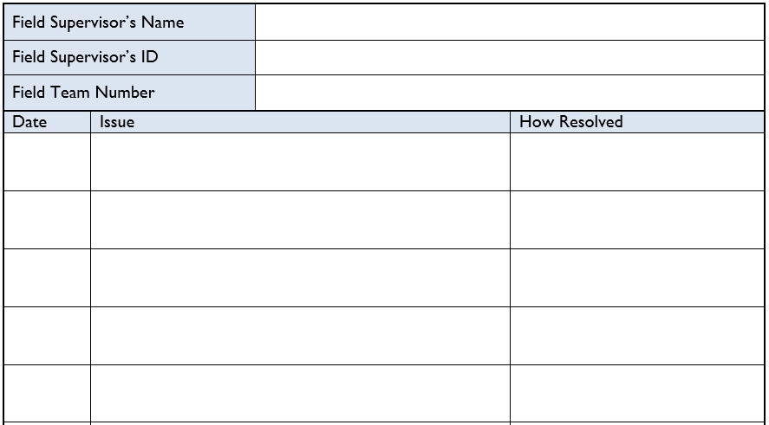
Annex G. Provision of Human Resources Support to Field Teams

Slide 45
Disclaimer:
This publication was prepared for review by the United States Agency for International Development. It was prepared for the Bureau for Food Security, United States Agency for International Development, USAID Contract Number GS-23F-8144H/AID-OAA-M-12-00006.
The authors’ views expressed in this publication do not necessarily reflect the views of the United States Agency for International Development or the United States government.
Recommended Citation:
Kiersten B. Johnson and Jasbir Kaur. 2018. Feed the Future Survey Methods Guidance: Quality Control and Support Team Training Slides. Washington, DC: Bureau for Food Security, U.S. Agency for International Development.
Contact Information:
Feed the Future
1300 Pennsylvania Ave, NW
Washington, DC 20004
www.feedthefuture.gov

Slide 46











U.S. Government Partners

